Slide 1

Generative AI for the .NET developer
Medhat Elmasry

Slide 2
Medhat Elmasry
Instructor at BCIT
Independent Contractor
Microsoft MVP since 2017
Founded .NET BC in 2003
Speaker
https://blog.medhat.ca
medhat@elmasry.ca

Slide 3
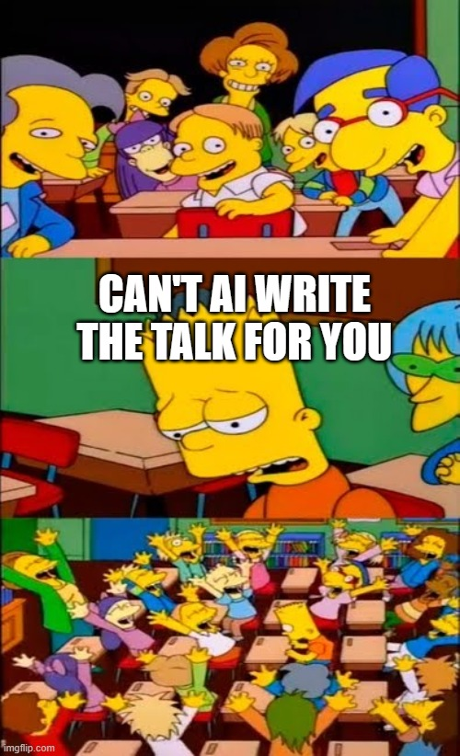

Slide 4
Demo
https://github.com/aaronpowell/youtubegpt

Slide 5
Generative AI

Slide 6


Large Language Models (LLMs)
“Once upon a time,
GPT 3.5
GPT 4
GPT 4o
“In a quaint village nestled between rolling hills and meandering streams, there existed […]. ”
N-token Prompt
M-token Completion

Slide 7
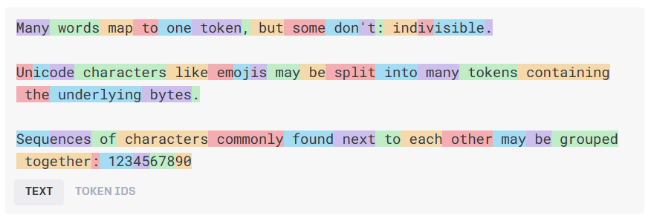
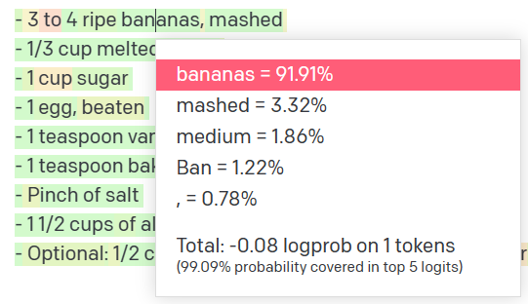
How language models work
Natural language input
Pre-processing
Tokens
Natural language output
Model
Get results
Decoding + Post-processing
Probability distribution

Slide 8
How language models work
n tokens in
1 tokens out
The LLM always predicts next token.

Slide 9
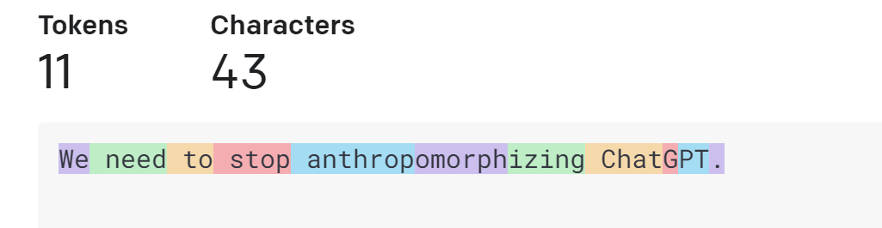
How language models work
Tokens
https://platform.openai.com/tokenizer

Slide 10
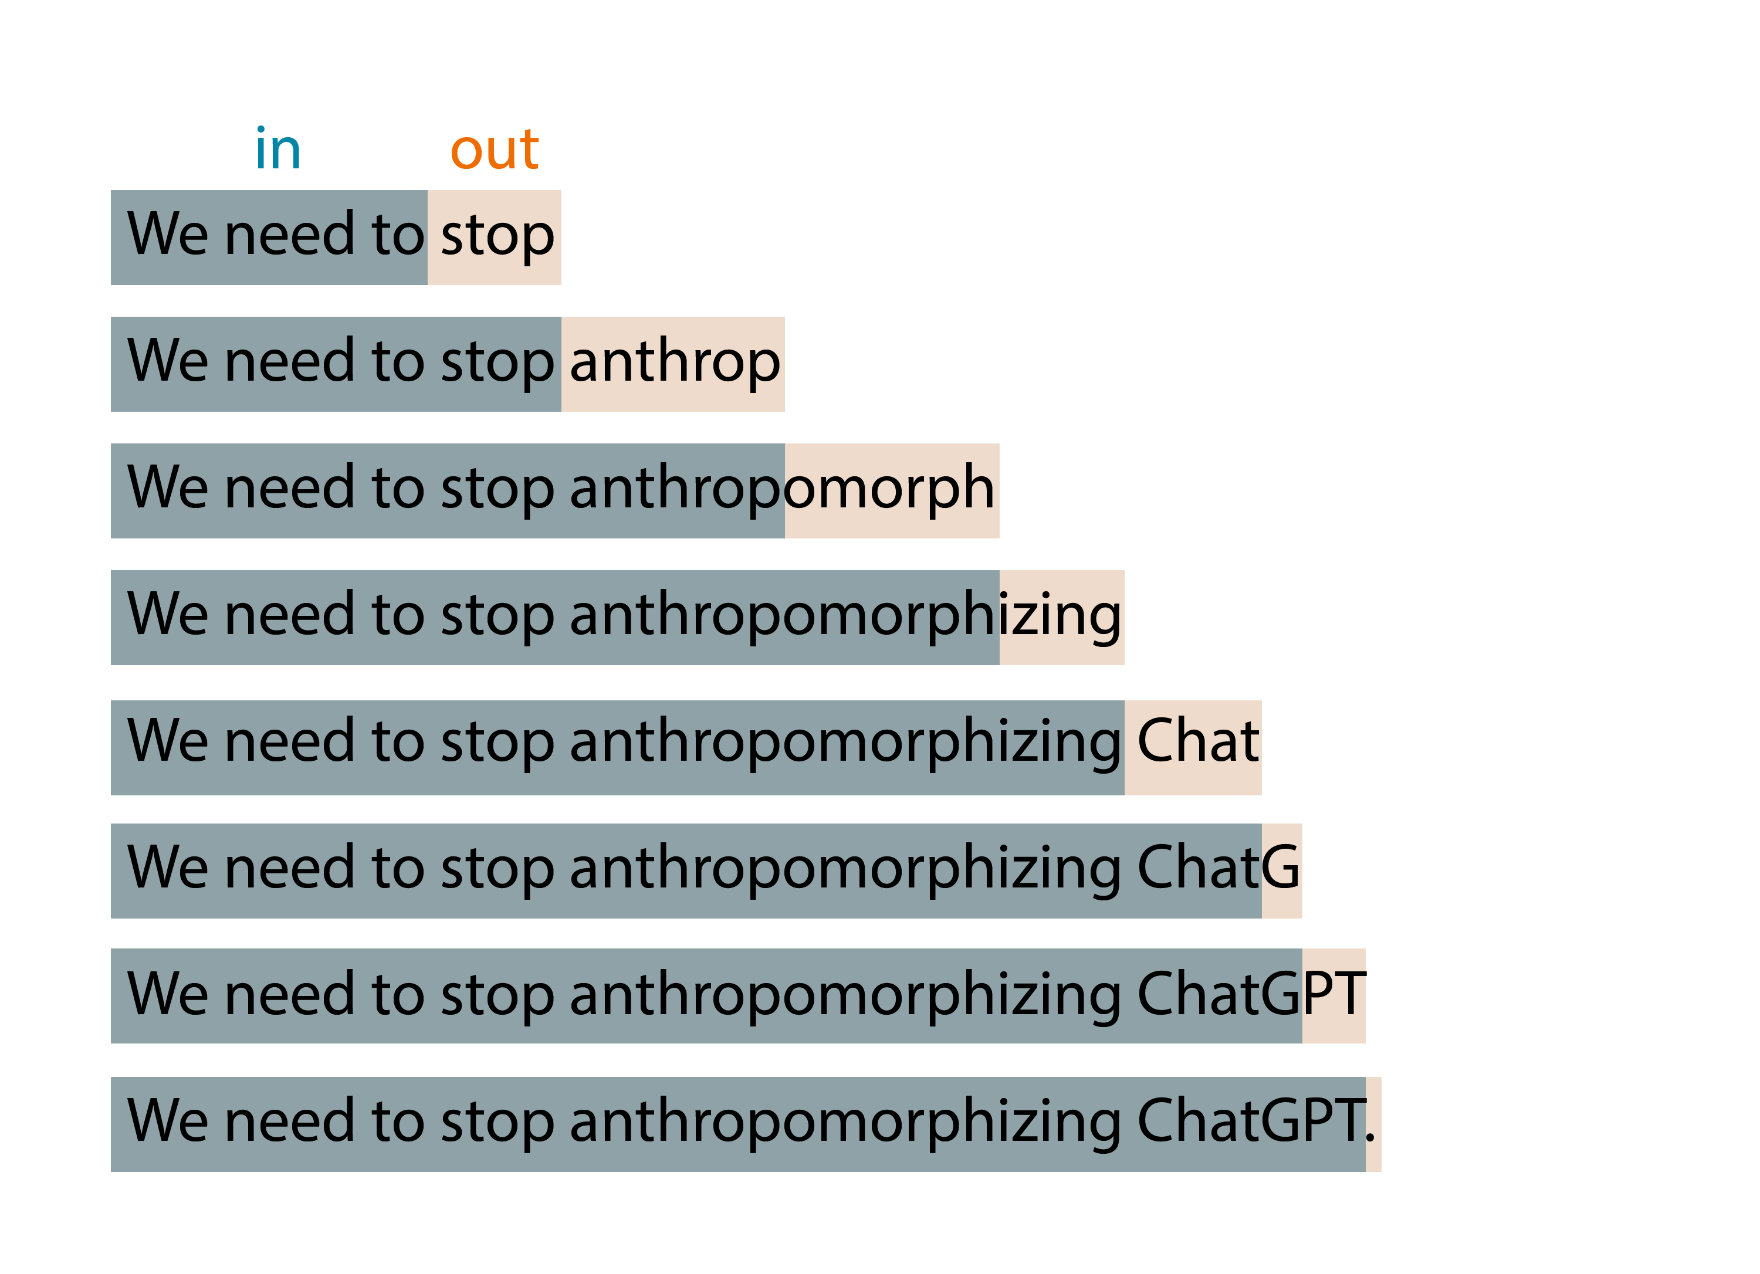
Language models just predict next token

Slide 11
How language models work
0.01
0.005
0.003
0.013
0.077
…
0.006
do
say
try
anthrop
buy
zux
We
need
to
stop
n tokens in
1 tokens out
p

Slide 12
Prompt Engineering

Slide 13
Prompt engineering
You can create your model prompt using different styles:
Instruction
e.g., “Translate the following code from Python to C# […]”
Completion
e.g., “Machine Learning is a field of artificial intelligence that”
Question
e.g., “What is Artificial Intelligence?”

Slide 14
Prompt engineering
You can create your model prompt using different styles:
Instruction
e.g., “Translate the following code from Python to C# […]”
Completion
e.g., “Machine Learning is a field of artificial intelligence that”
Question
e.g., “What is Artificial Intelligence?”
TIP – Imagine you are speaking to an untrained intern
Avoid assumptions
Break down problems
Provide details

Slide 15

System prompt vs user prompt
System prompt
You are an AI assistant that helps people find information and respond in rhyme. If the user asks you a question you don't know the answer to, say so.
User prompt
What can you tell about me, John Doe?
Assistant
Dear John, I'm sorry to say,
But I don't have info on you today.
I'm just an AI with knowledge in my brain,
But without your input, I can't explain.
So please tell me more about what you seek,
And I'll do my best to give you an answer unique.

Slide 16
Talking in text

Slide 17

Common text generation use cases
Content generation
Summarization
Code generation
Semantic search
Chat

Slide 18
Prompt engineering for text generation
Defining assistant persona, its tone and style, and the chat history
1
Providing examples, context and data (meta-grounding)
2
Providing guardrails and mitigating fabrications
3

Slide 19
Demo – Generating Text
GeneratingTextConsole

Slide 20
Talking in numbers

Slide 21
GenAI Features: Embeddings
[-0.006655829958617687, 0.0026128944009542465, 0.008792596869170666, -0.02446001023054123, -0.008540431968867779, 0.022071078419685364, -0.010703742504119873, 0.003311325330287218, -0.011632772162556648, -0.02187200076878071, ...]
“Today we are going to learn about Azure AI Studio”
Text Embedding Ada

Slide 22
Demo – Embeddings
EmbeddingsDemoSK

Slide 23
Demo – Smart Components
https://github.com/dotnet-smartcomponents/smartcomponents
EfFuncCallSK
Notes:
https://github.com/dotnet-smartcomponents/smartcomponents

Slide 24
Executing custom logic

Slide 25
Azure OpenAI Function Calling
Meta Prompt
Prompt
Prompt
Response
You're an AI assistant designed to help users search for hotels. When a user asks for help finding a hotel, you should call the search_hotels function.
Function
{
"name": "search_hotels",
"description": "Retrieves hotels from the search index based",
"parameters": {
"type": "object", "properties": {
"location": { "type": "string",
"description": "The location of the hotel (i.e. Seattle, WA)"
},
”max_price": { "type": ”number",
"description": "The maximum price for the hotel"
},
},
"required": ["location","max_price"]
}
}
Hotel with a private beach cost max 300 euro in Delmaris.
{ "location":"Delmaris", "max_price": 300, }

Slide 26
Demo - Functions
EfFuncCallSK (continued…)

Slide 27
Speech

Slide 28

Speech IN (Speech to Text)
The ocelot, Lepardus paradalis, is a small wild cat native to the southwestern United States, Mexico, and Central and South America. This medium-sized cat is characterized by solid black spots and streaks on its coat, [...]
OpenAI Whisper
Live transcription

Slide 29
Speech OUT (Text to Speech)
To best meet your needs, I would recommend the following.
OpenAI Whisper

Slide 30
Demo – Text to Speech
EfFuncCallSK (continued…)

Slide 31
Model Knowledge

Slide 32
The knowledge gap
Training data (up to)
Prompt
User prompt
GPT4o October 2023
GPT4 gpt-4-32k(0613) September 2021
gpt-4 (1106-preview) April 2023
GPT3.5 gpt-35-turbo (0613) gpt-35-turbo (1106) September 2021
Is Queen Elizabeth II still alive?
Assistant
As of my last update, Queen Elizabeth II is still alive. However, please note that my information might not be up to date, so I recommend verifying it with a reliable source.

Slide 33
Doesn't know my data
User prompt
I need warm waterproof shoes
to go on a hike.
Assistant
Sure! I can help you with that. When it comes to warm and waterproof shoes for hiking, there are a few options available. Here are some popular brands and models to consider:
Salomon X Ultra Winter CS WP: These shoes are designed for winter hiking and feature waterproof protection, insulation, and a supportive outsole.

Slide 34
Adding knowledge to the prompt
Meta Prompt
Prompt
Prompt
Response
## Task
You are an AI agent for the Contoso Trek outdoor products retailer. As the agent, you answer questions briefly, succinctly, and in a personable manner using markdown and even add some personal flair with appropriate emojis.
Sure, I'd be happy to help! 😊 Based on the available documentation, I can recommend two choices from the Contoso Trek catalog.
Product: TrailWalker Hiking Shoes ID: 36244753 Brand: TrekReady […]
I need warm waterproof shoes
to go on a hike.
## Documents The following documentation should be used in the response. The response should specifically include the product id.
TrailWalker hiking Shoes
The Adventurer Pro Backpack is designed to provide comfort, durability, and ample storage space for your outdoor adventures. Familiarize yourself with the key features of the backpack […]
TrekHiker Walking Booths The Adventurer Pro Backpack is designed to provide comfort, durability, and ample storage space for your outdoor adventures. Familiarize yourself with the key features of the backpack […]

Slide 35
Retrieval Augmented Generation (RAG)
User Question
Workflow
Query My Data
Retriever over Knowledge Base
Add Results to Prompt
Query Model
Large Language Model
Send Results

Slide 36
Demo: YouTubeGPT

Slide 37
In closing
AI means a lot, but right now it’s mostly Generative AI
Azure OpenAI Service for GPT models
https://github.com/aaronpowell/youtubegpt

Slide 38

Microsoft wants to hear from YOU!
Attendee Survey
Season of AI | Microsoft Community
2024
User Group Name: .NET User Group of BC
aka.ms/AttendeeSurveySeasonOfAI
Notes:
Remind attendees to participate in the event survey

Slide 39
Thank you

